Slide 1
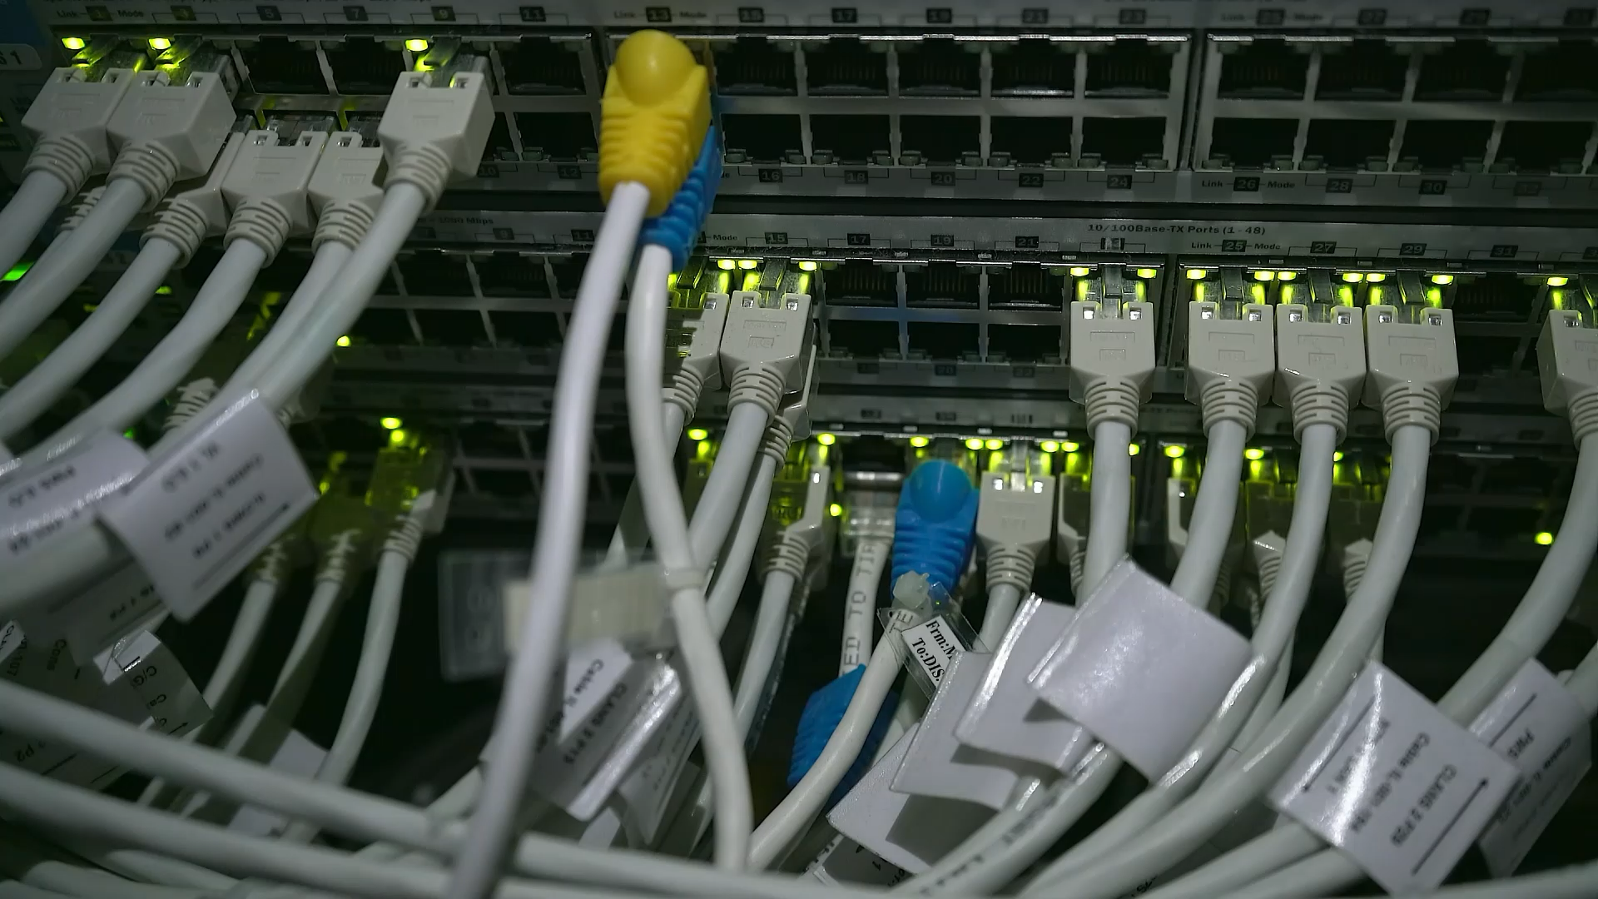
CONNECTTEL CUSTOMER CHURN PREDICTION REPORT

Slide 2

OVERVIEW
Business Challenge
Potential Benefits
Descriptive Report (EDA)
Customer Churn %
Business Profitability Insight
Churn Prediction Model
Business Strategy/ Recommendations

Slide 3

BUSINESS CHALLENGE
Background:
A Telecom company with a pressing need to address customer churn which poses a significant threat to its business sustainability and growth. The company’s current customer retention strategies lack precision and effectiveness, resulting in the loss of valuable customers to competitors.
Problem Statement:
To develop a robust customer churn prediction system that will accurately forecast customer churn, and also implement targeted retention initiatives through insights developed from the forecasted customer churn/churn prediction system.
AIM:
To enable Connecttel to reduce customer attrition, enhance customer loyalty, and maintain a competitive edge in the highly dynamic and competitive telecommunications industry.

Slide 4

POTENTIAL BENEFITS?
The following are the potential benefits of this analysis;
An improved understanding and knowledge of the overall business performance over the specified period which provides valuable insights for improvement in business activities.
Enhanced customer-targeted retention and profit-making strategies.
A good understanding of customer churn and why customers churn within the business.
A well-developed and effective churn prediction model to forecast and predict churn.
The opportunity to develop a broader understanding of the business scope and make valuable business decisions.
The ability to forecast and predict future trends which allows for easy and better planning and strategizing.
It will save cost in the long run and improve business sustainability and growth.

Slide 5

DESCRIPTIVE REPORT
This is a summary of the company’s current customer and product descriptive statistics. It comprises of information such as; the total number of customers, gender distribution, customer age bracket, and customer tenure Distribution, contract type, payment method, internet service types, total monthly income, total profit by customers for the whole period.
This report was carried out through an explorative data analysis, and it is visualized as below;

Slide 6
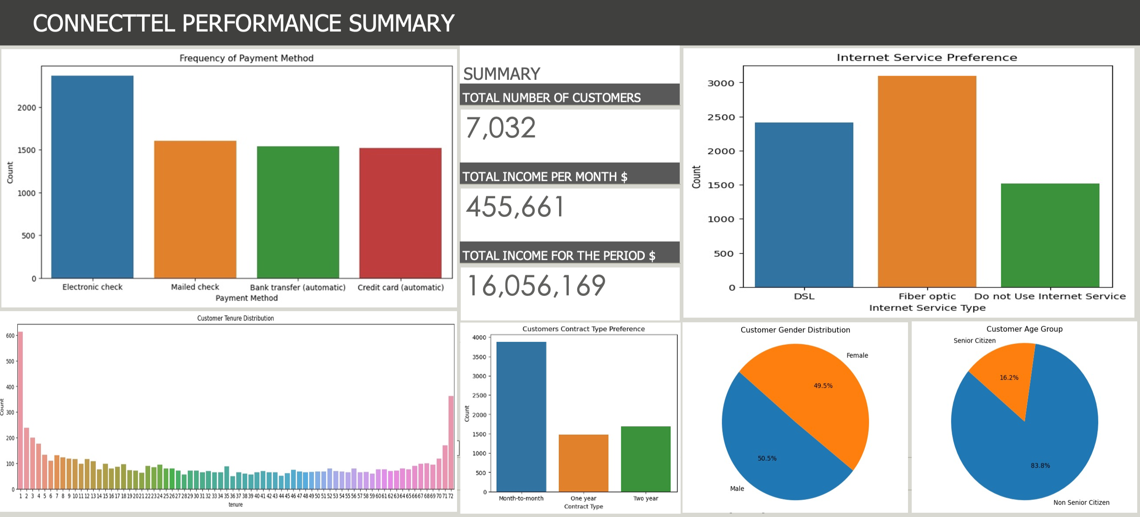

Slide 7
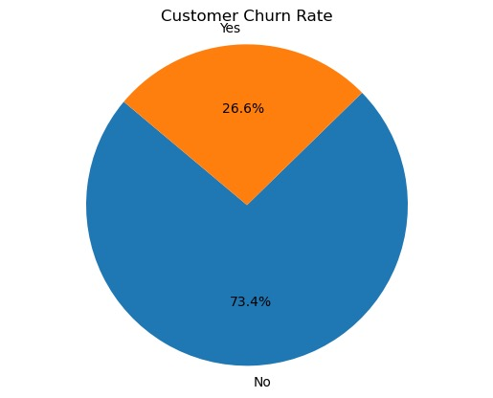
CUSTOMER CHURN%
Customer churn is the total number of customers that have stopped using the company’s product or service within the period of about 72 months according to the information obtained from the company’s workable data.
The churn rate is calculated according to percentage of customers that have been lost , as displayed;
It is Mathematically Calculated as;
CHURN= Customer Lost Over a Period of Time / Customers at the Start of That Time * 100 Total number of customers at Connecttel = 7,032

Slide 8

BUSINESS PROFITABILITY INSIGHT
To be cost-effective, the clients/ customers have been segmented using exploratory data analysis to identify correlations and visualize the subset of customers and factors/services that have the potential to influence profit, customer loyalty and longevity within the specified period in the business.
Churn customers have been used to identify /understand why customers are leaving. This is achieved by identifying patterns in spending behaviour, and use of the products available in the business.

Slide 9
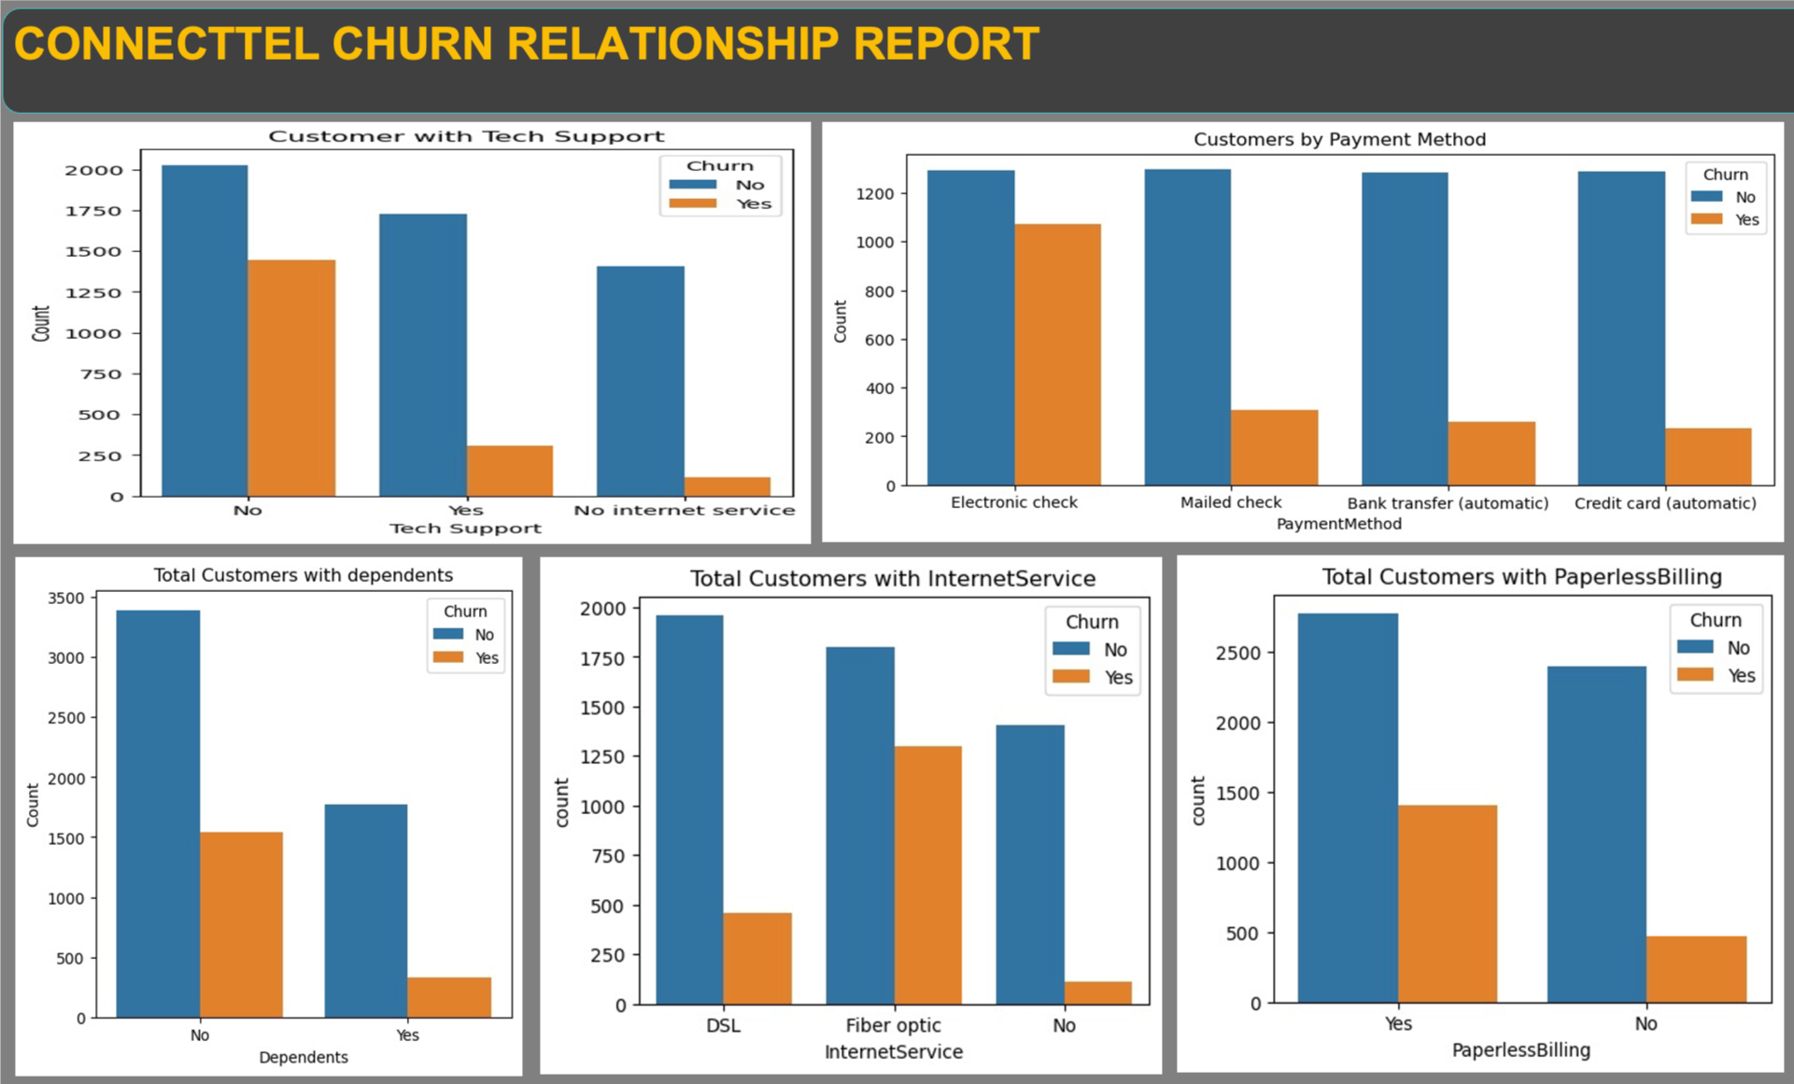

Slide 10
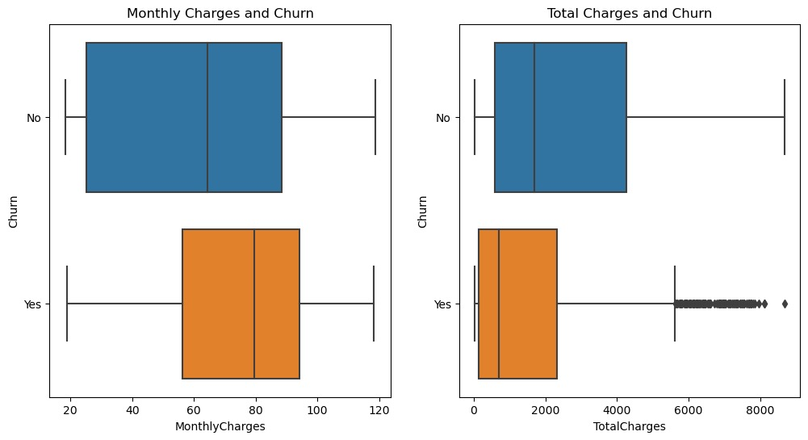
When monthly charges are high, churn tends to increase but when total charges are high churn tends to decrease. It is also observed that the relationship between these two factors is linked to contract type which can ultimately affect customer longevity.

Slide 11
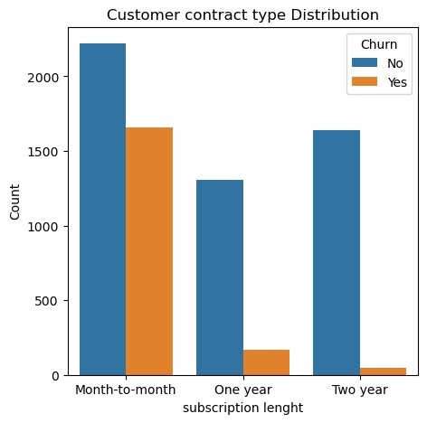
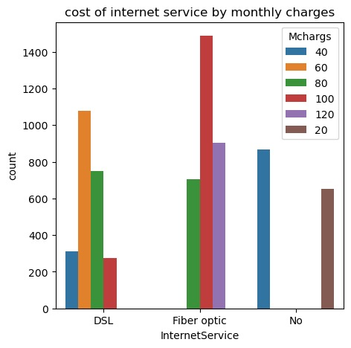
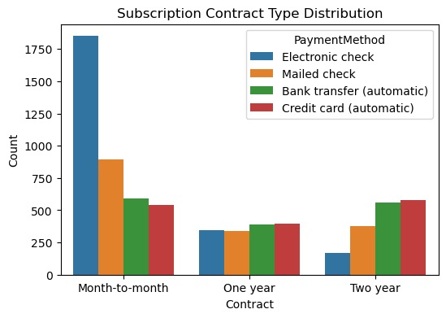
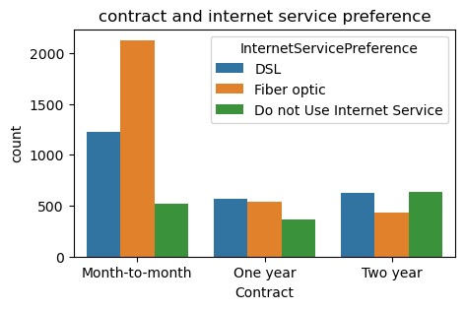
Some other factors affecting high monthly charges and customer longevity;
Customers on monthly subscription packages have extreme churn rates compared to yearly subscribers.
It is observed that customers who use Fiber Optic internet service incur very high monthly charges over others.
One or two-year contract customers use mostly automated bank transfer and credit card payment methods or have a more balanced spread of other payment methods than monthly contract customers who use mostly electronic payment type
Customers on a one or two -year contract type mostly use DSL or non-internet service and have a more balanced use of both internet services than customers on a monthly contract type.

Slide 12

FINDINGS
Tenure or customer longevity is closely linked to longer contract types, and longer contract types increase total charges (income) and have less churn potential.
The high cost of Fiber Optic internet service may have significant negative impact on customer churn as customers who use them the most (especially monthly contract customers) tend to churn more. Customers who use Fiber Optic might have medium to high monthly charges which is associated with high churn rates.
It can be concluded that there might be difficulties or delays faced by customers who use the electronic check payment method over other payment methods which could potentially discourage subscription package renewals and other purchases thereby leading to churn. customers with month-to-month contract types are the largest users of this payment method type.
Lack of accessibility to tech support and use of other services like online backup, paperless billing, and online security to all customers has a major negative impact on churn.
Customers with dependents or partners may spend more and tend to churn less according to the analysis.

Slide 13

CHURN PREDICTION MODEL
The churn prediction model was developed by building and training various Machine Learning Algorithms, from which the best and most accurate model was chosen for the purpose of predicting churn within Connecttel.
The following are the models that where trained and the reason for choosing them;
Logistic Regression Algorithm: it is good for binary classifications and can be extended to multiclass. The data set also showed some level of linearity where an increase in one variable meant a decrease in the other.
Random Forest Model: the introduction of randomness in the construction of individual trees ensures model diversity thereby increasing accuracy, making it suitable for this type of dataset.
Decision Tree Classifier: it splits data in the form of a binary tree, which is good for the target variable type in the data set.

Slide 14
Evaluation of the models;
Logistic Regression (LR) had an accuracy of 79.7% prediction of instances in the data set.
Random Forest had an accuracy of 79.5%
Decision Tree had an accuracy of 72%
Out of these three models, the Logistic Regression Machine Learning Algorithm emerged as the most accurate to be used to tackle the problem of customer churn for Connecttel.
It predicted the highest in general in terms of; AUC-ROC 71%, Precision is 62.9%, Recall is 53%, and F1-score 57.6%. However, there is room for improvement in these areas.
According to the results of the evaluation, the Confusion Matrix shows that the ‘LR’ model was able to give 926 accurate Positive predictions(TP), and 195 accurate Negative predictions (TN) from 20% of the instances in the dataset. However, there were 115 False Positives (FP) and 171 False Negatives (FN).
This model is the best for the dataset out of the three models used because it has the lowest number of False Negatives (which is when the predicted value is ‘negative’ but the actual is ‘positive’).
The False Negatives are the main focus for the business because it is the area where the ML model will not predict accurately that customers will be lost. Thereby making it the most effective to reduce the risk of customer loss at Connecttel.

Slide 15
To evaluate the success rate of the model on the current churn rate;
Churn Prediction Effectiveness:
The 171 instances represent a total number of False Negatives in every 20% of the total number of customers or instances from the dataset.
Hence, 171 * 5 = 855 instances out of a total of 7,032 customers.
Therefore, 855 / 7,032 * 100 = 12.2% Risk.
When applied to the current churn rate, the model will reduce churn from 26.6% to 12.2% which is a 14.4% decrease.
According to financial statistics, for e.g, a 5% increase in customer retention produces more than a 25% increase in profit, because return customers tend to buy more from a company over time which decreases operating cost to serve them.
This means that a 14.4% decrease in churn or increase in customer retention has the potential to increase profit by up to 74.5%.

Slide 16

Limitations of this model
It cannot capture complex relationships in data without transformation; it is not effective with non-linear data unless feature engineering is applied. However, normalization and one-hot feature encoding were used to transform the dataset before model building.

Slide 17

BUSINESS RETENTION STRATEGY RECOMMENDATIONS
Improve the efficiency of the electronic check payment method by carrying out a customer survey to identify potential difficulties faced by customers who use it or discontinue its use.
Direct more services and target more customers with partners and dependents (families) as they have more longevity, tend to churn less and spend more.
Contract type strategy; encourage and sustain yearly subscription contract packages by making them more attractive or giving bonuses to attract more customers and possibly reduce monthly subscribers who tend to churn more thereby increasing customer longevity as evidenced by the data analysis.
Reduce paper billings and develop an automated billing system to save time and cost.
Attach bonuses to the use of DSL internet service to attract more customers as it is evident that customers who use DSL have more longevity over Fiber Optic users. This is especially true for monthly subscribers who tend to be more than yearly subscribers.
Survey the use of Fiber Optic internet service to develop insight into customer challenges and reason for churning associated with its use and take necessary actions.
Provide more tech support, online backup, device protection, and online security services or include them in the subscription packages as people who do not have these services tend to churn more than those who have them.
Develop a 360 feedback system starting from the most loyal customers to the least, to develop insight into the business customer service precision.

Slide 18

THANK YOU

